Slide 1
Potato Chip Mailing Contest
Group #8

Slide 2
Objective/Requirements
Build a container that can safely hold a potato chip without it breaking. The more it gets damaged the more points will be taken off. Then team with the highest score will be the winner f the Wednesday Challenge.

Slide 3
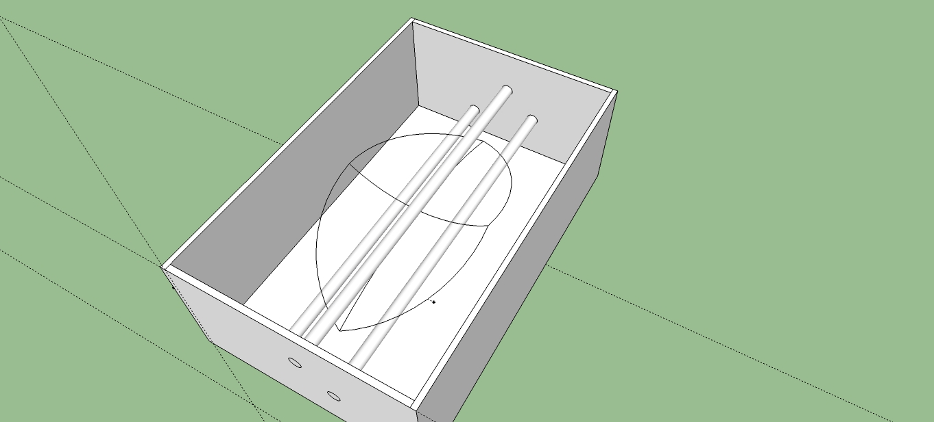
Design

Slide 4
Predicted Score with Explanation
Predicted Score: 10
Calculation: Final Score= (Chip Rating)/(Volume*Mass/1000)
(100) / (182 * 55/1000)= 9.99000999

Slide 5
Parts List
Cardboard Box | Rubber Bands | Shredded Cotton Balls (pulled apart) | Clear Packing Tape
1 | 3 | Enough cotton balls to weaken the impact but not too much. It’ll affect and break the potato chip so be wise on the amount going in the box. | Just to tape over the knots of the rubber bands to secure.

Slide 6
Photo of Mailed Container

Slide 7
Data
Official Score

Slide 8
Lessons Learned
What worked well
What would you change next time
If your predicted score differed from your actual, why?

